Slide 1


Build Your Website with RStudio and blogdown
Melinda Higgins

Slide 2
Install software & setup
R & RStudio
https://cran.r-project.org/
https://www.rstudio.com/products/rstudio/download/#download
Install blogdown package
https://cran.r-project.org/web/packages/blogdown/index.html
Install GIT
https://git-scm.com/downloads
Signup for Github account
https://github.com/
Signup for Netlify account
https://www.netlify.com/

Slide 3
Resources, tutorials & examples
Blogdown book https://bookdown.org/yihui/blogdown/
Alison Presmanes Hill blogpost https://alison.rbind.io/post/up-and-running-with-blogdown/ [June 2017]
Tyler Clavelle blogpost https://tclavelle.github.io/blog/blogdown_github/
Peter Baumgartner 4 part blog series https://notes.peter-baumgartner.net/tutorial/blogdown-tutorial-part-1/
Emily C. Zabor http://www.emilyzabor.com/tutorials/rmarkdown_websites_tutorial.html

Slide 4

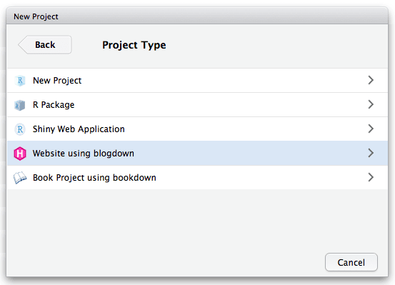
Download Desktop Open Source Edition https://www.rstudio.com/products/rstudio/download/#download
Version at least v1.1.383 to use the New Project Menu Interface

Slide 5
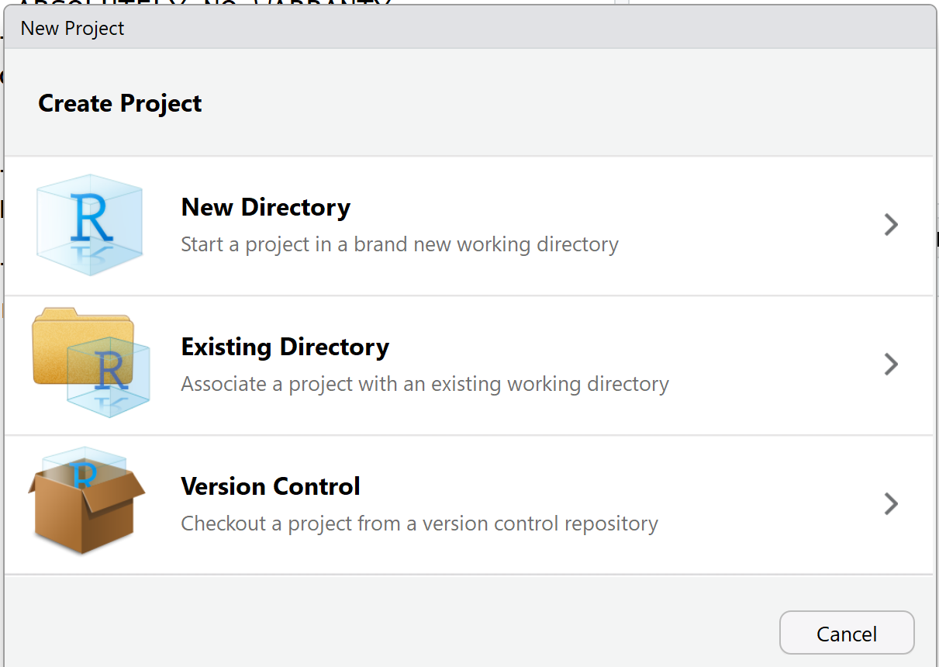
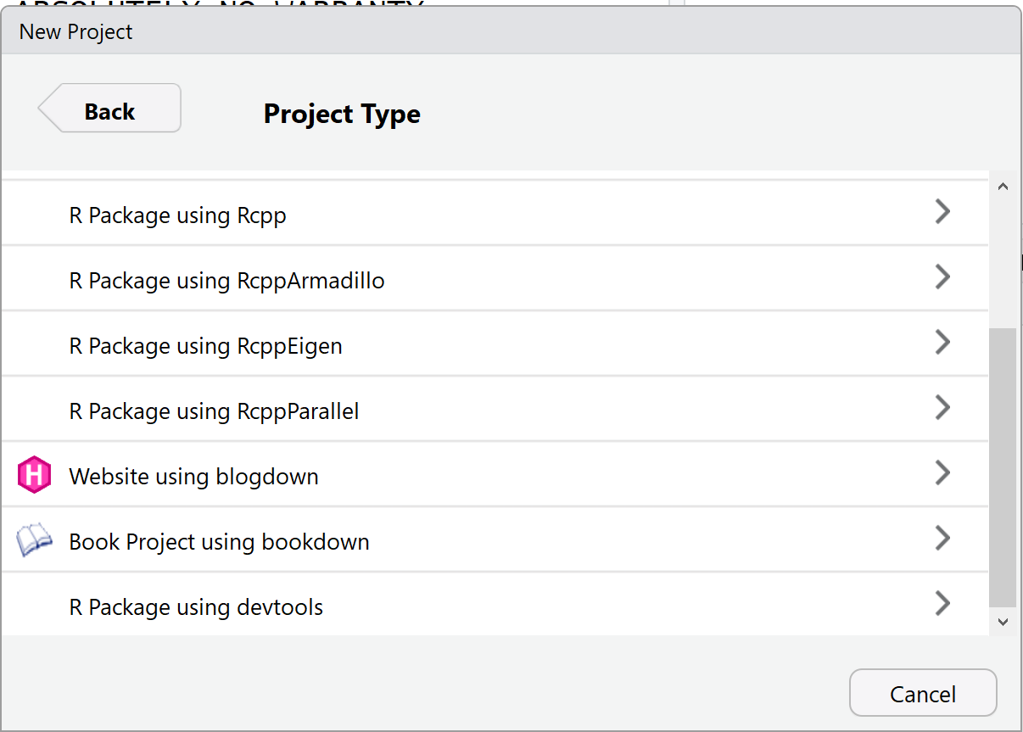
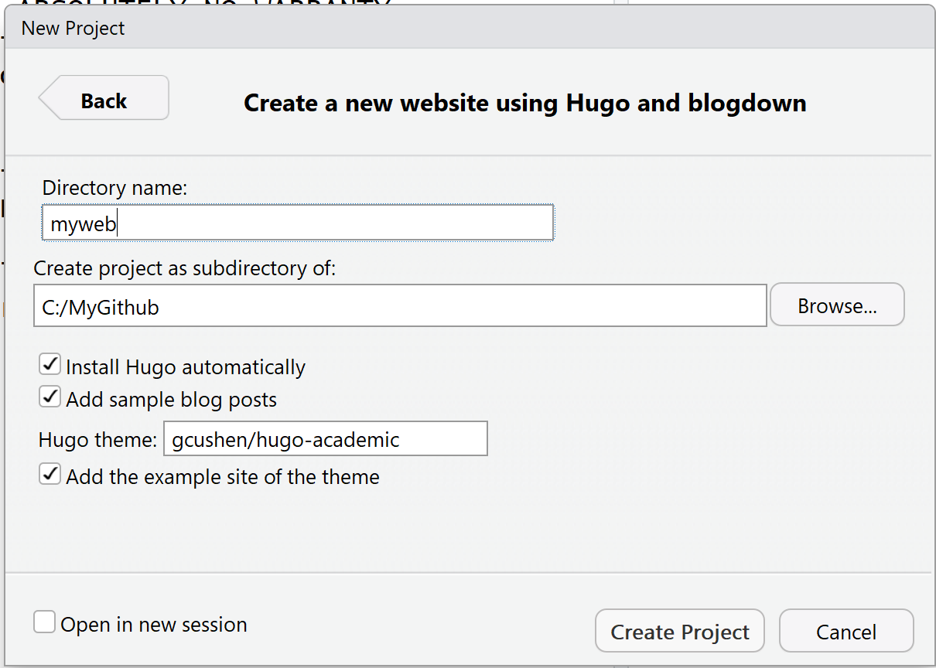

Slide 6
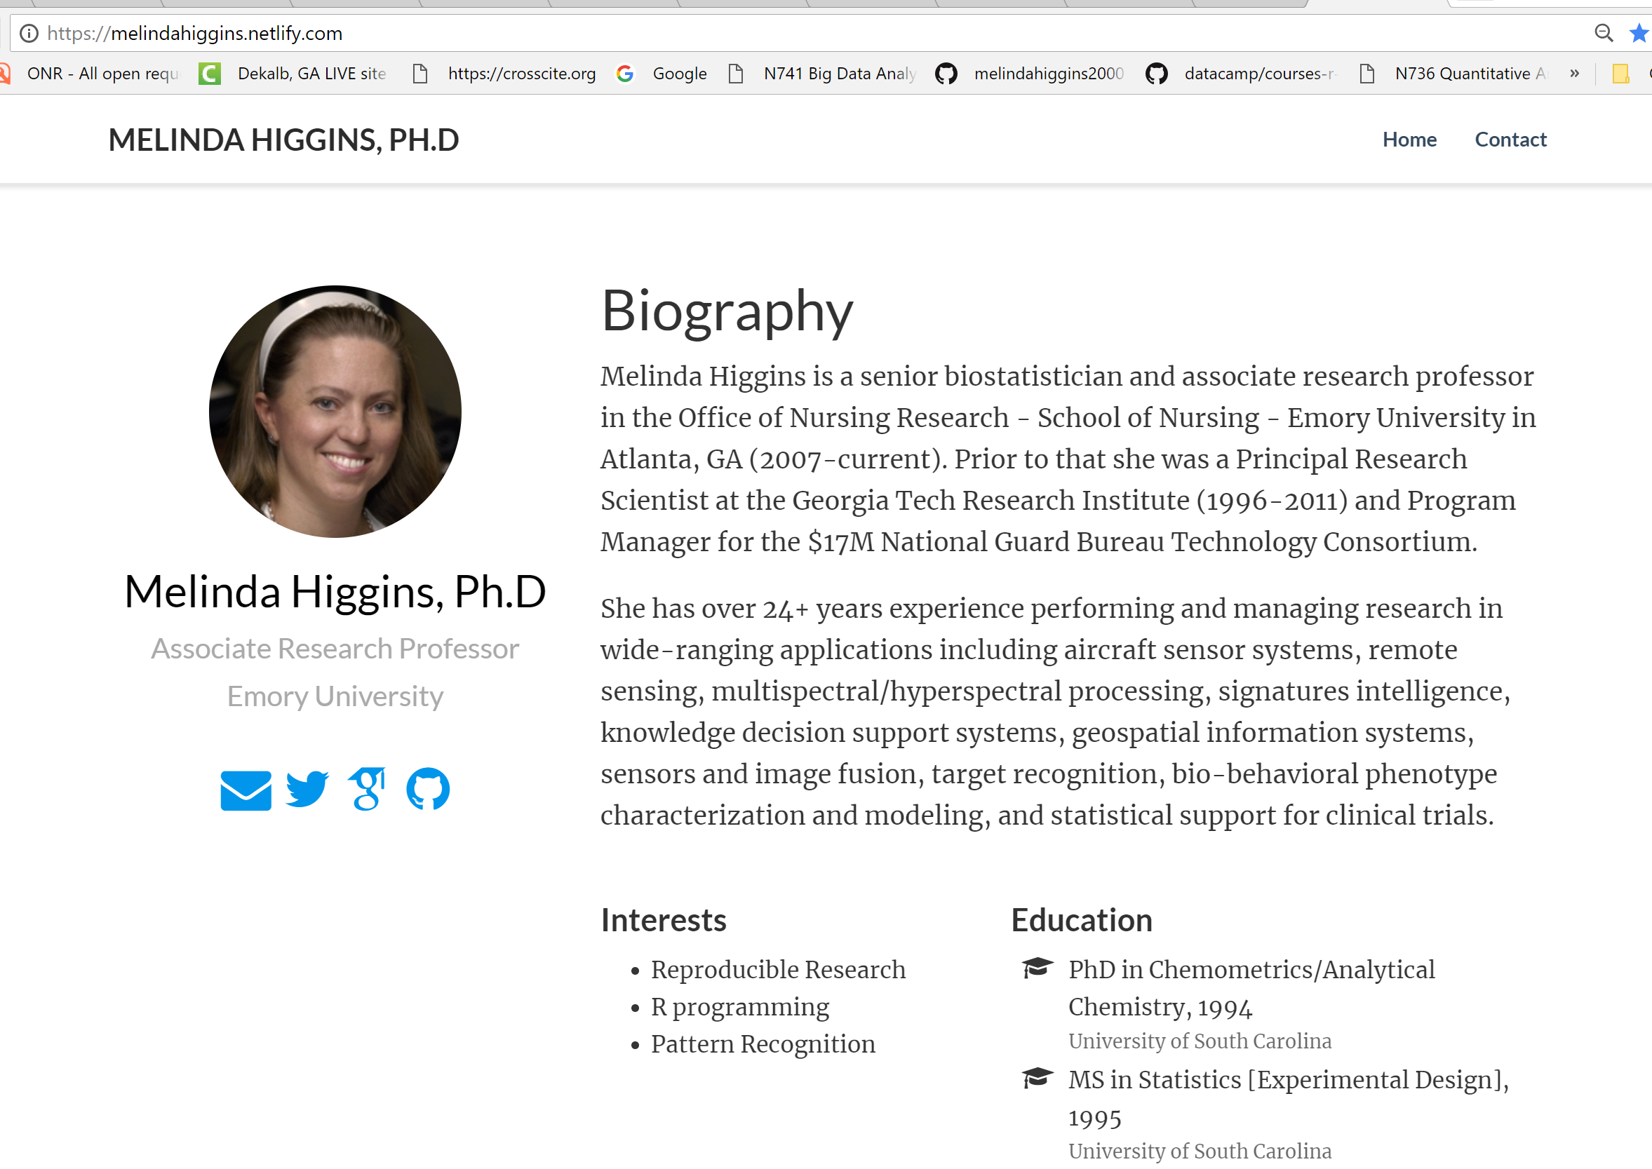
Hugo theme academic
https://github.com/gcushen/hugo-academic
https://sourcethemes.com/academic/
https://themes.gohugo.io/academic/

Slide 7
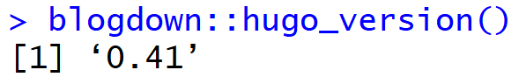
RStudio – New Project/Website with blogdown
Hugo is installed automatically
Check version

Slide 8
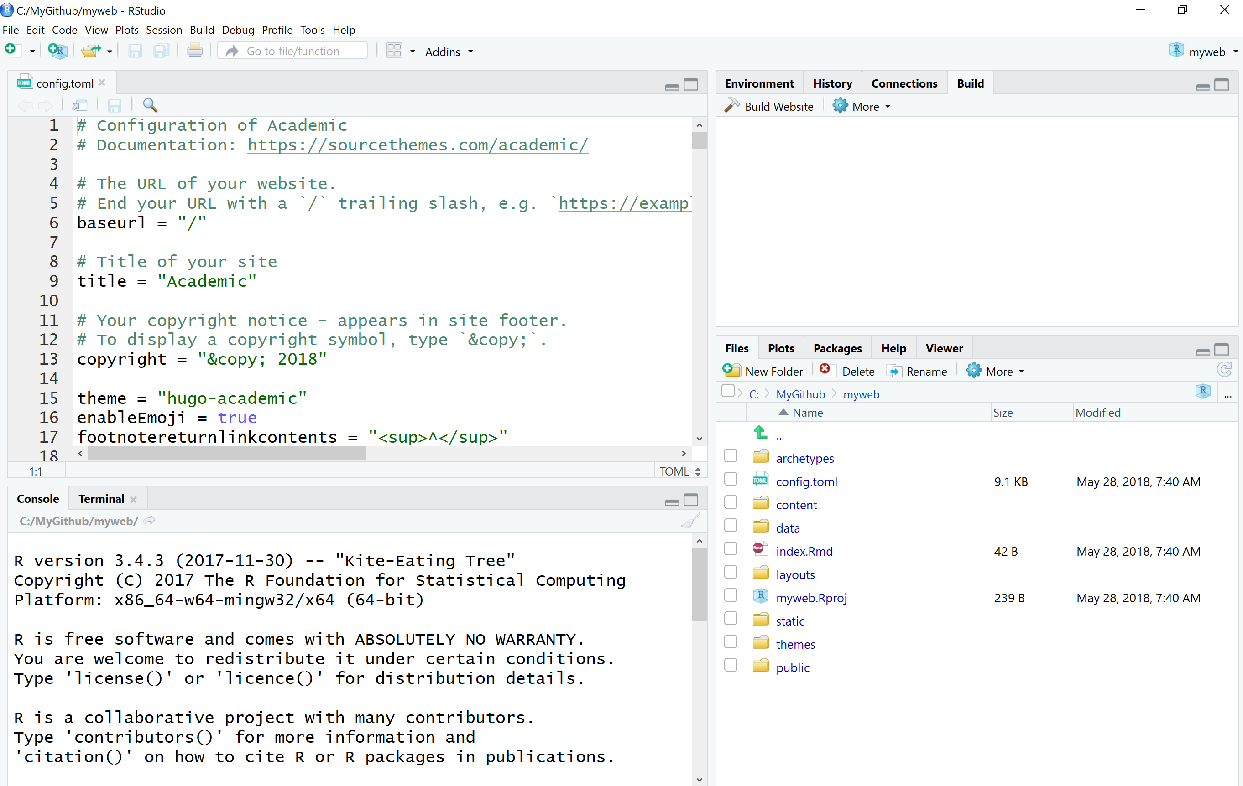
config.toml sets up the configuration of your website, learn more at http://gohugo.io/getting-started/configuration/

Slide 9
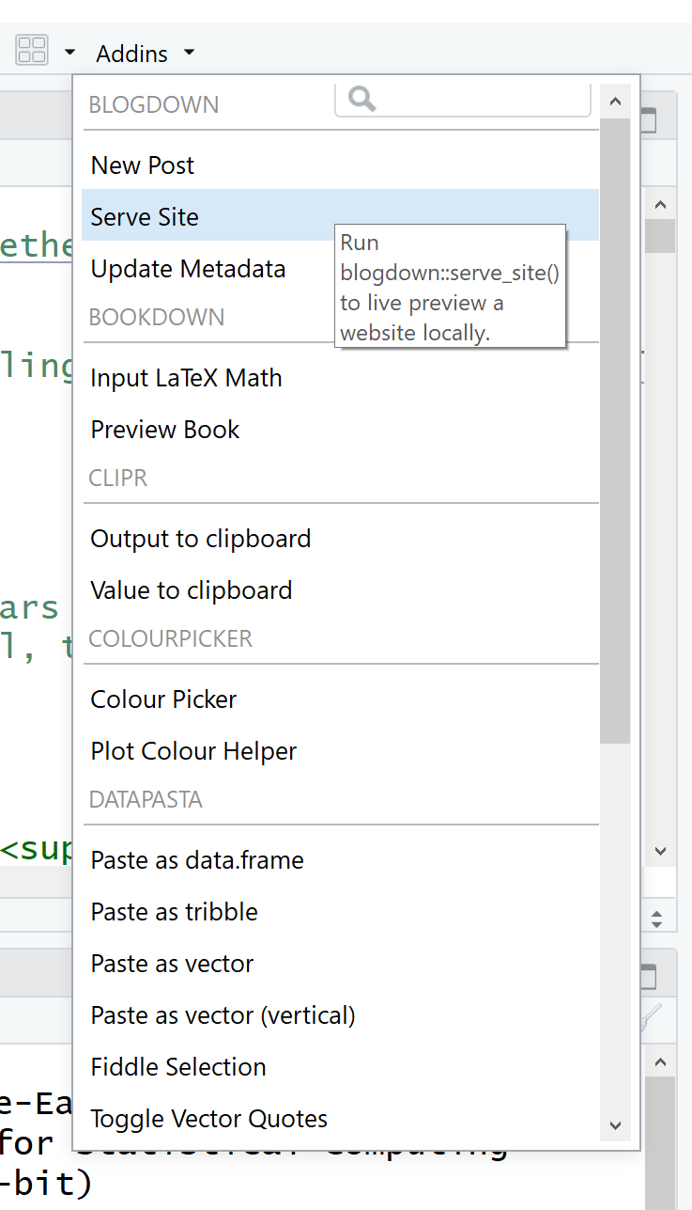
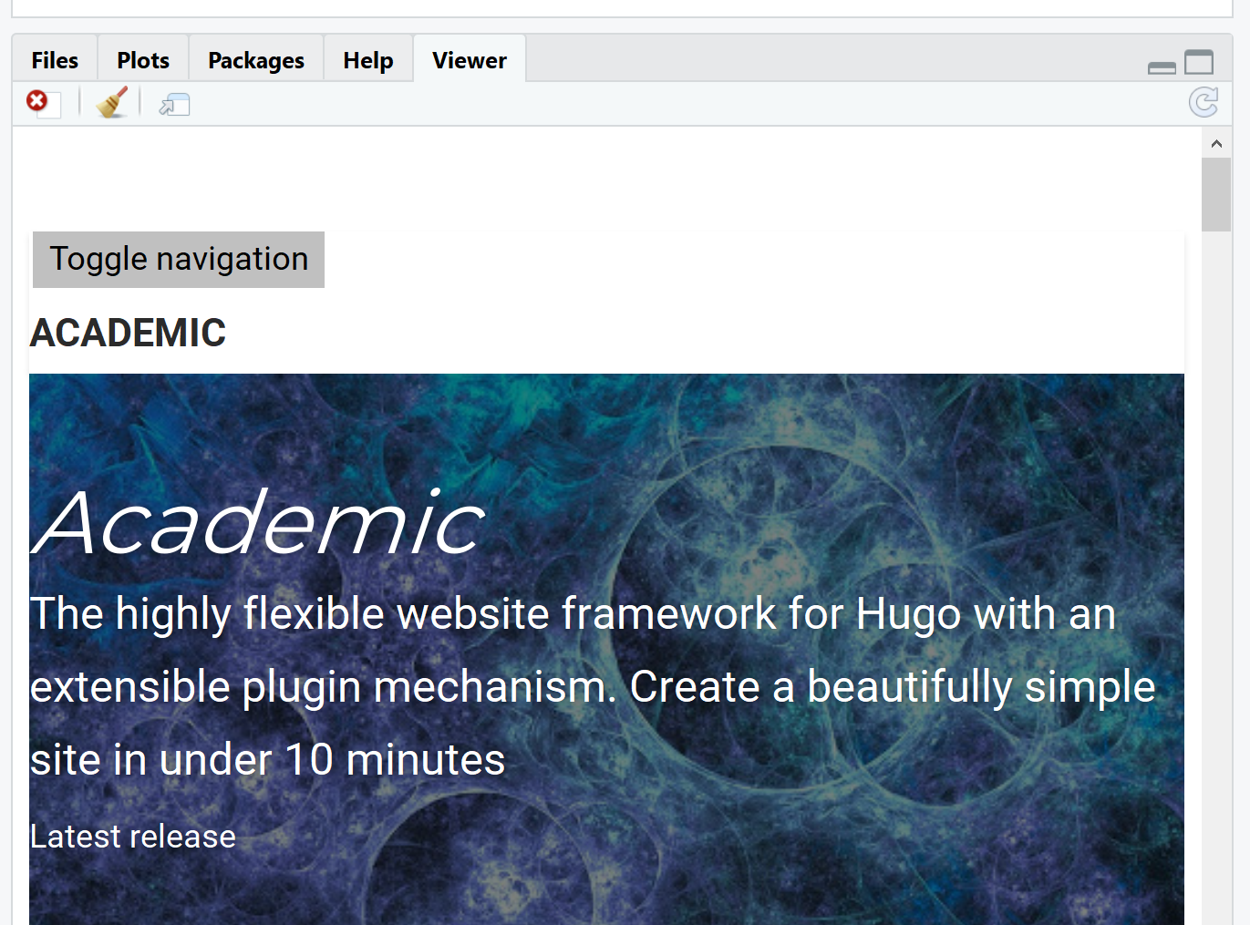
RStudio Addins

Slide 10
Let’s make some changes to config.toml
In config.toml – change
title = "Academic” to
title = "My New Academic Website“
Click save for config.toml – watch Viewer window – the title automatically updates

Slide 11
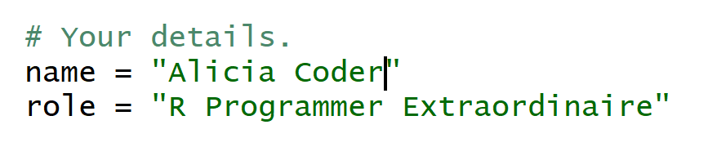
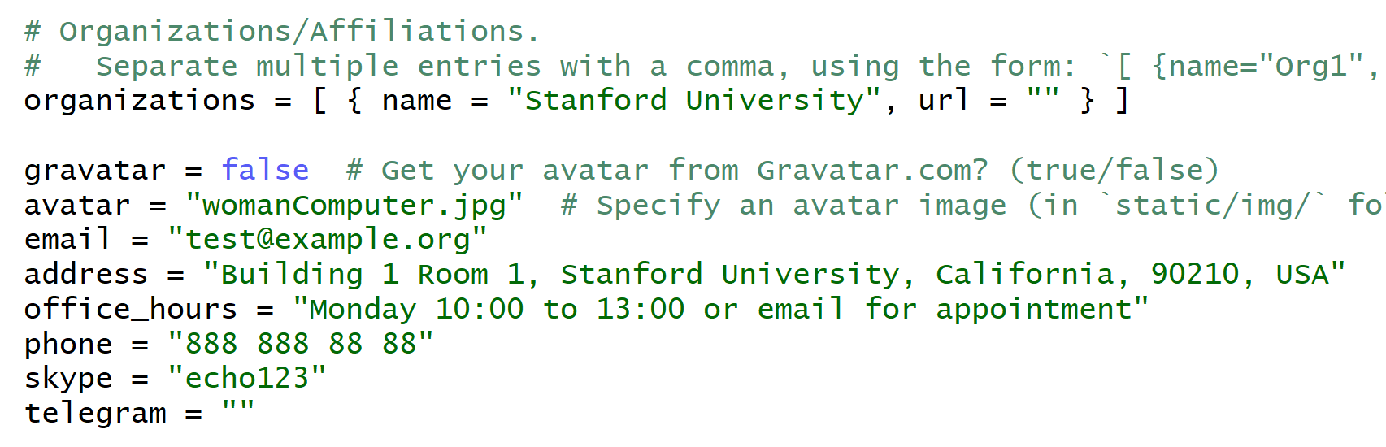

In config.toml – scroll down to [params]
Change name, role,
Change avatar, add image to static/img/ folder in project directory
Click save

Slide 12
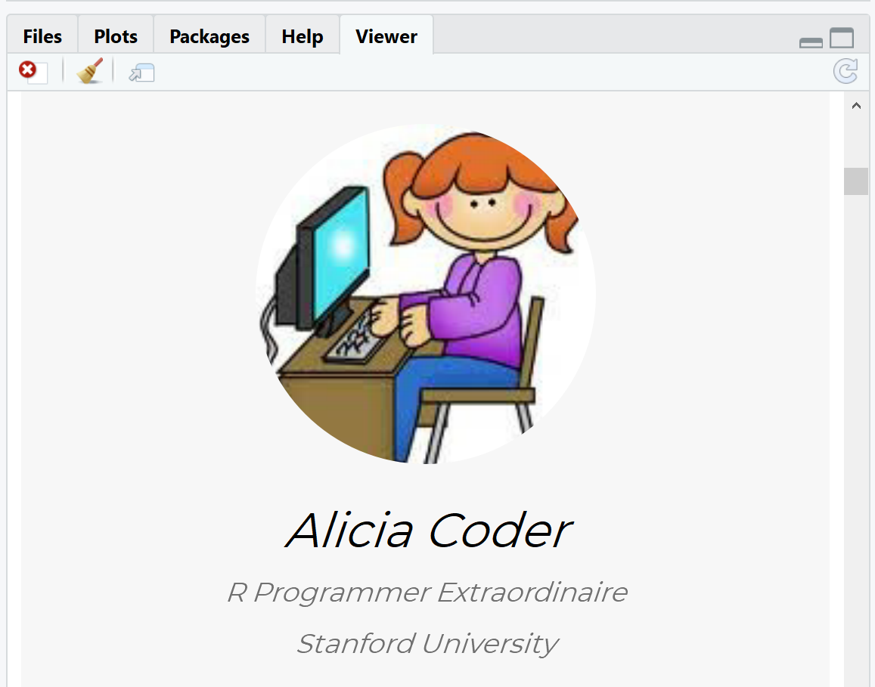
See Updates in rstudio Viewer window

Slide 13
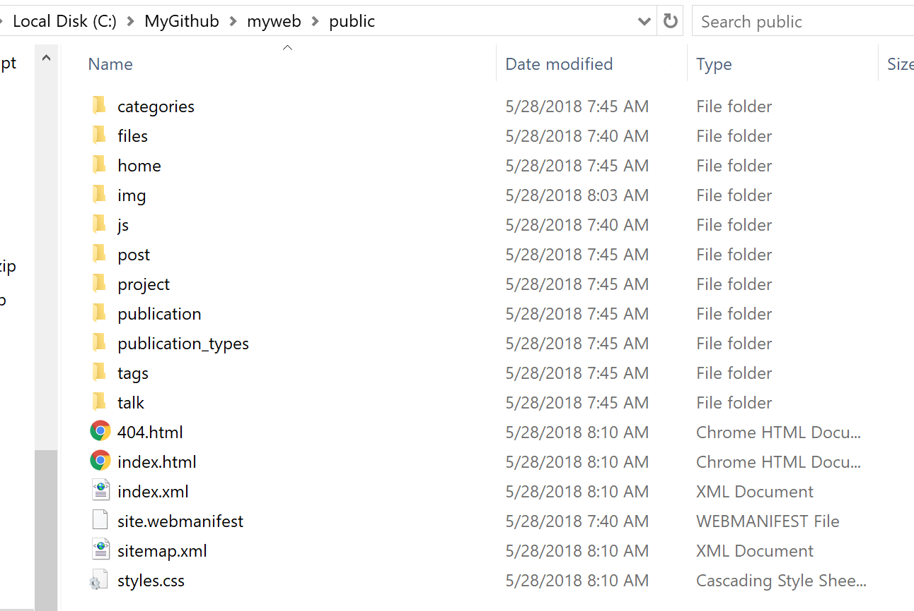
Where is my website? Local computer – public/ subfolder

Slide 14
Deploy to Github
Create new repository – no readme – name same as directory “myweb”
Use git bash window – go to directory “myweb”
git init
git remote add origin https://github.com/melindahiggins2000/myweb.git
git add .
git commit –m “initial commit”
git push -u origin master
Github account
Repository name

Slide 15
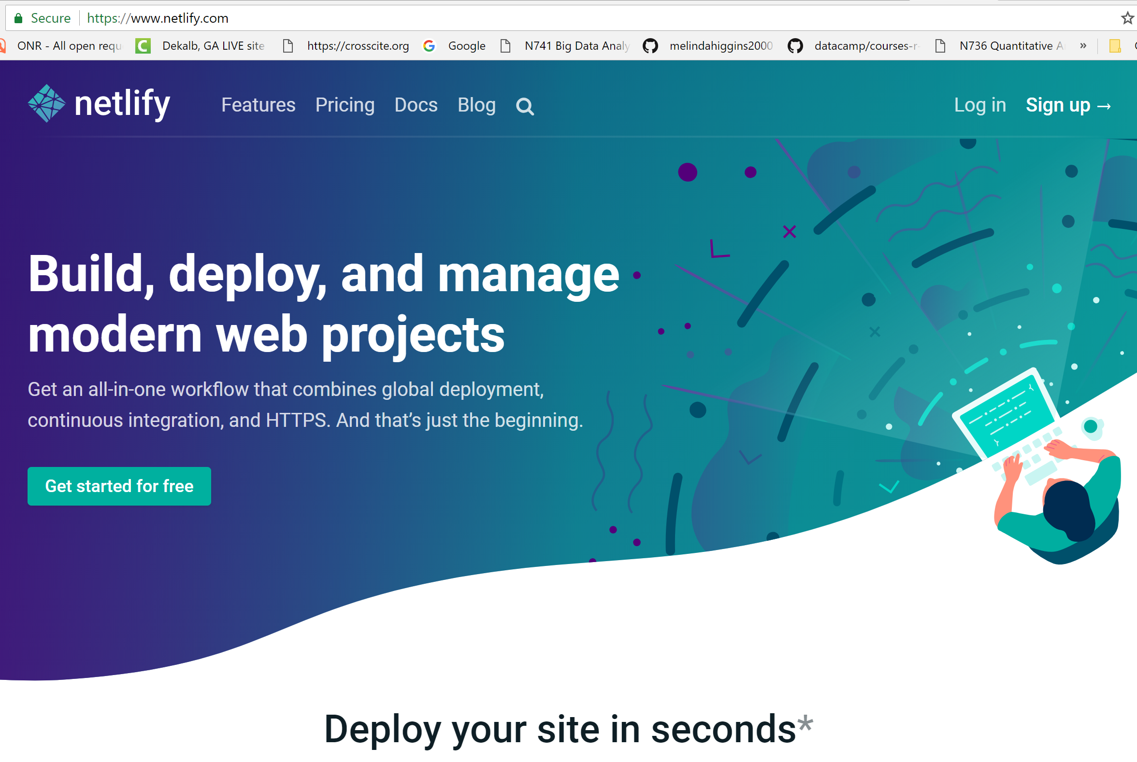
Use netlify

Slide 16
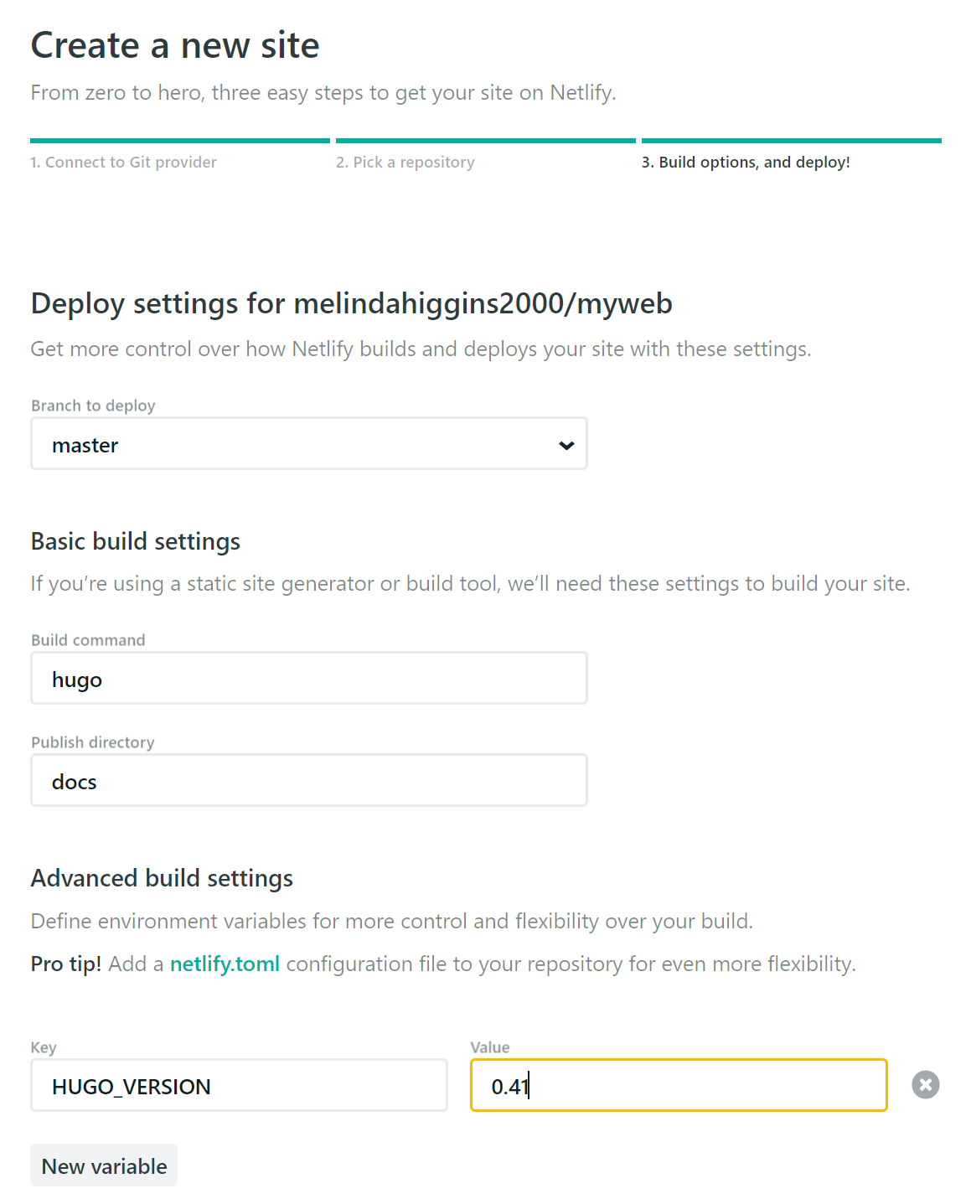
netlify
Login via github/signup
Click new site from git
Authorize Netlify to Access Github
Click github – find repo
public
https://notes.peter-baumgartner.net/tutorial/blogdown-tutorial-part-4/

Slide 17
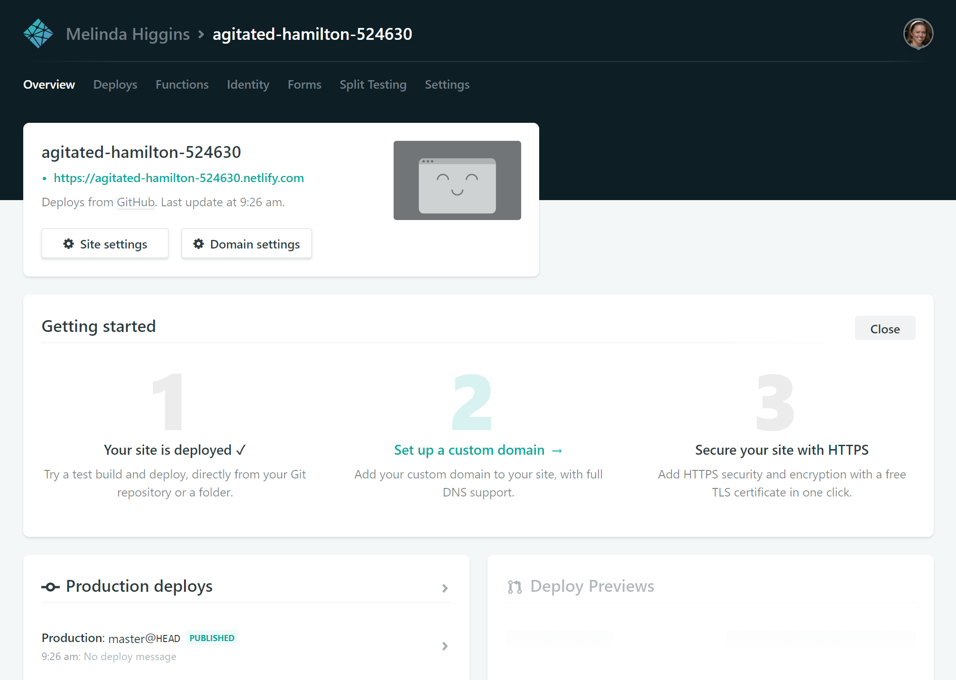

Slide 18
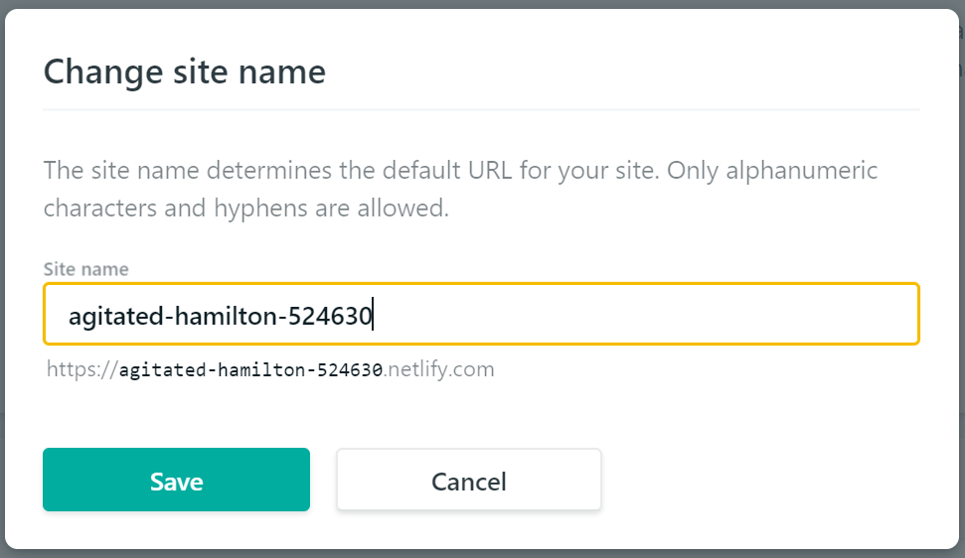

Slide 19
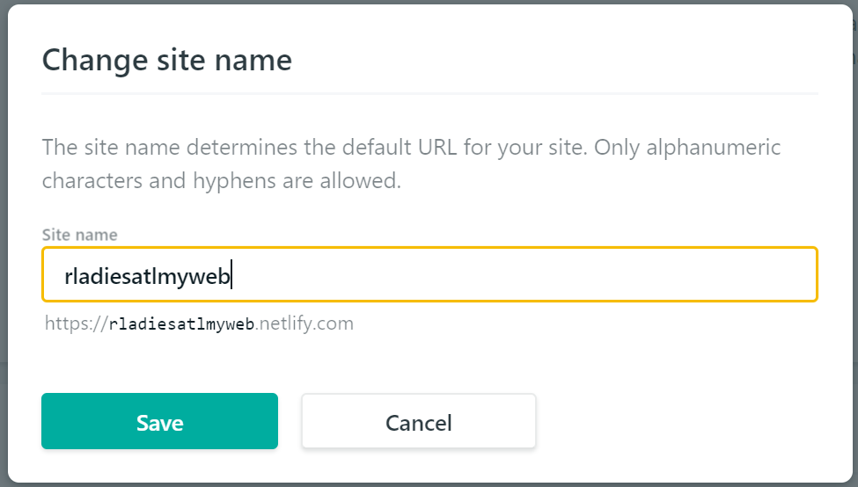

Slide 20
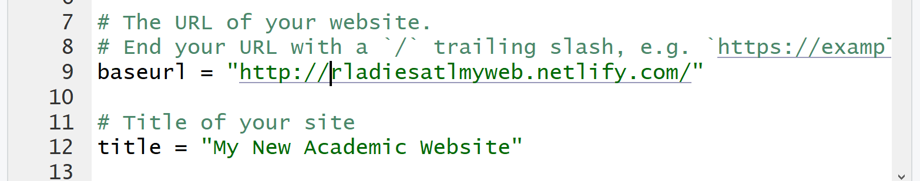
Fix baseurl
Addins – serve site
git add .
git commit –m “updated baseurl”
git push

Slide 21
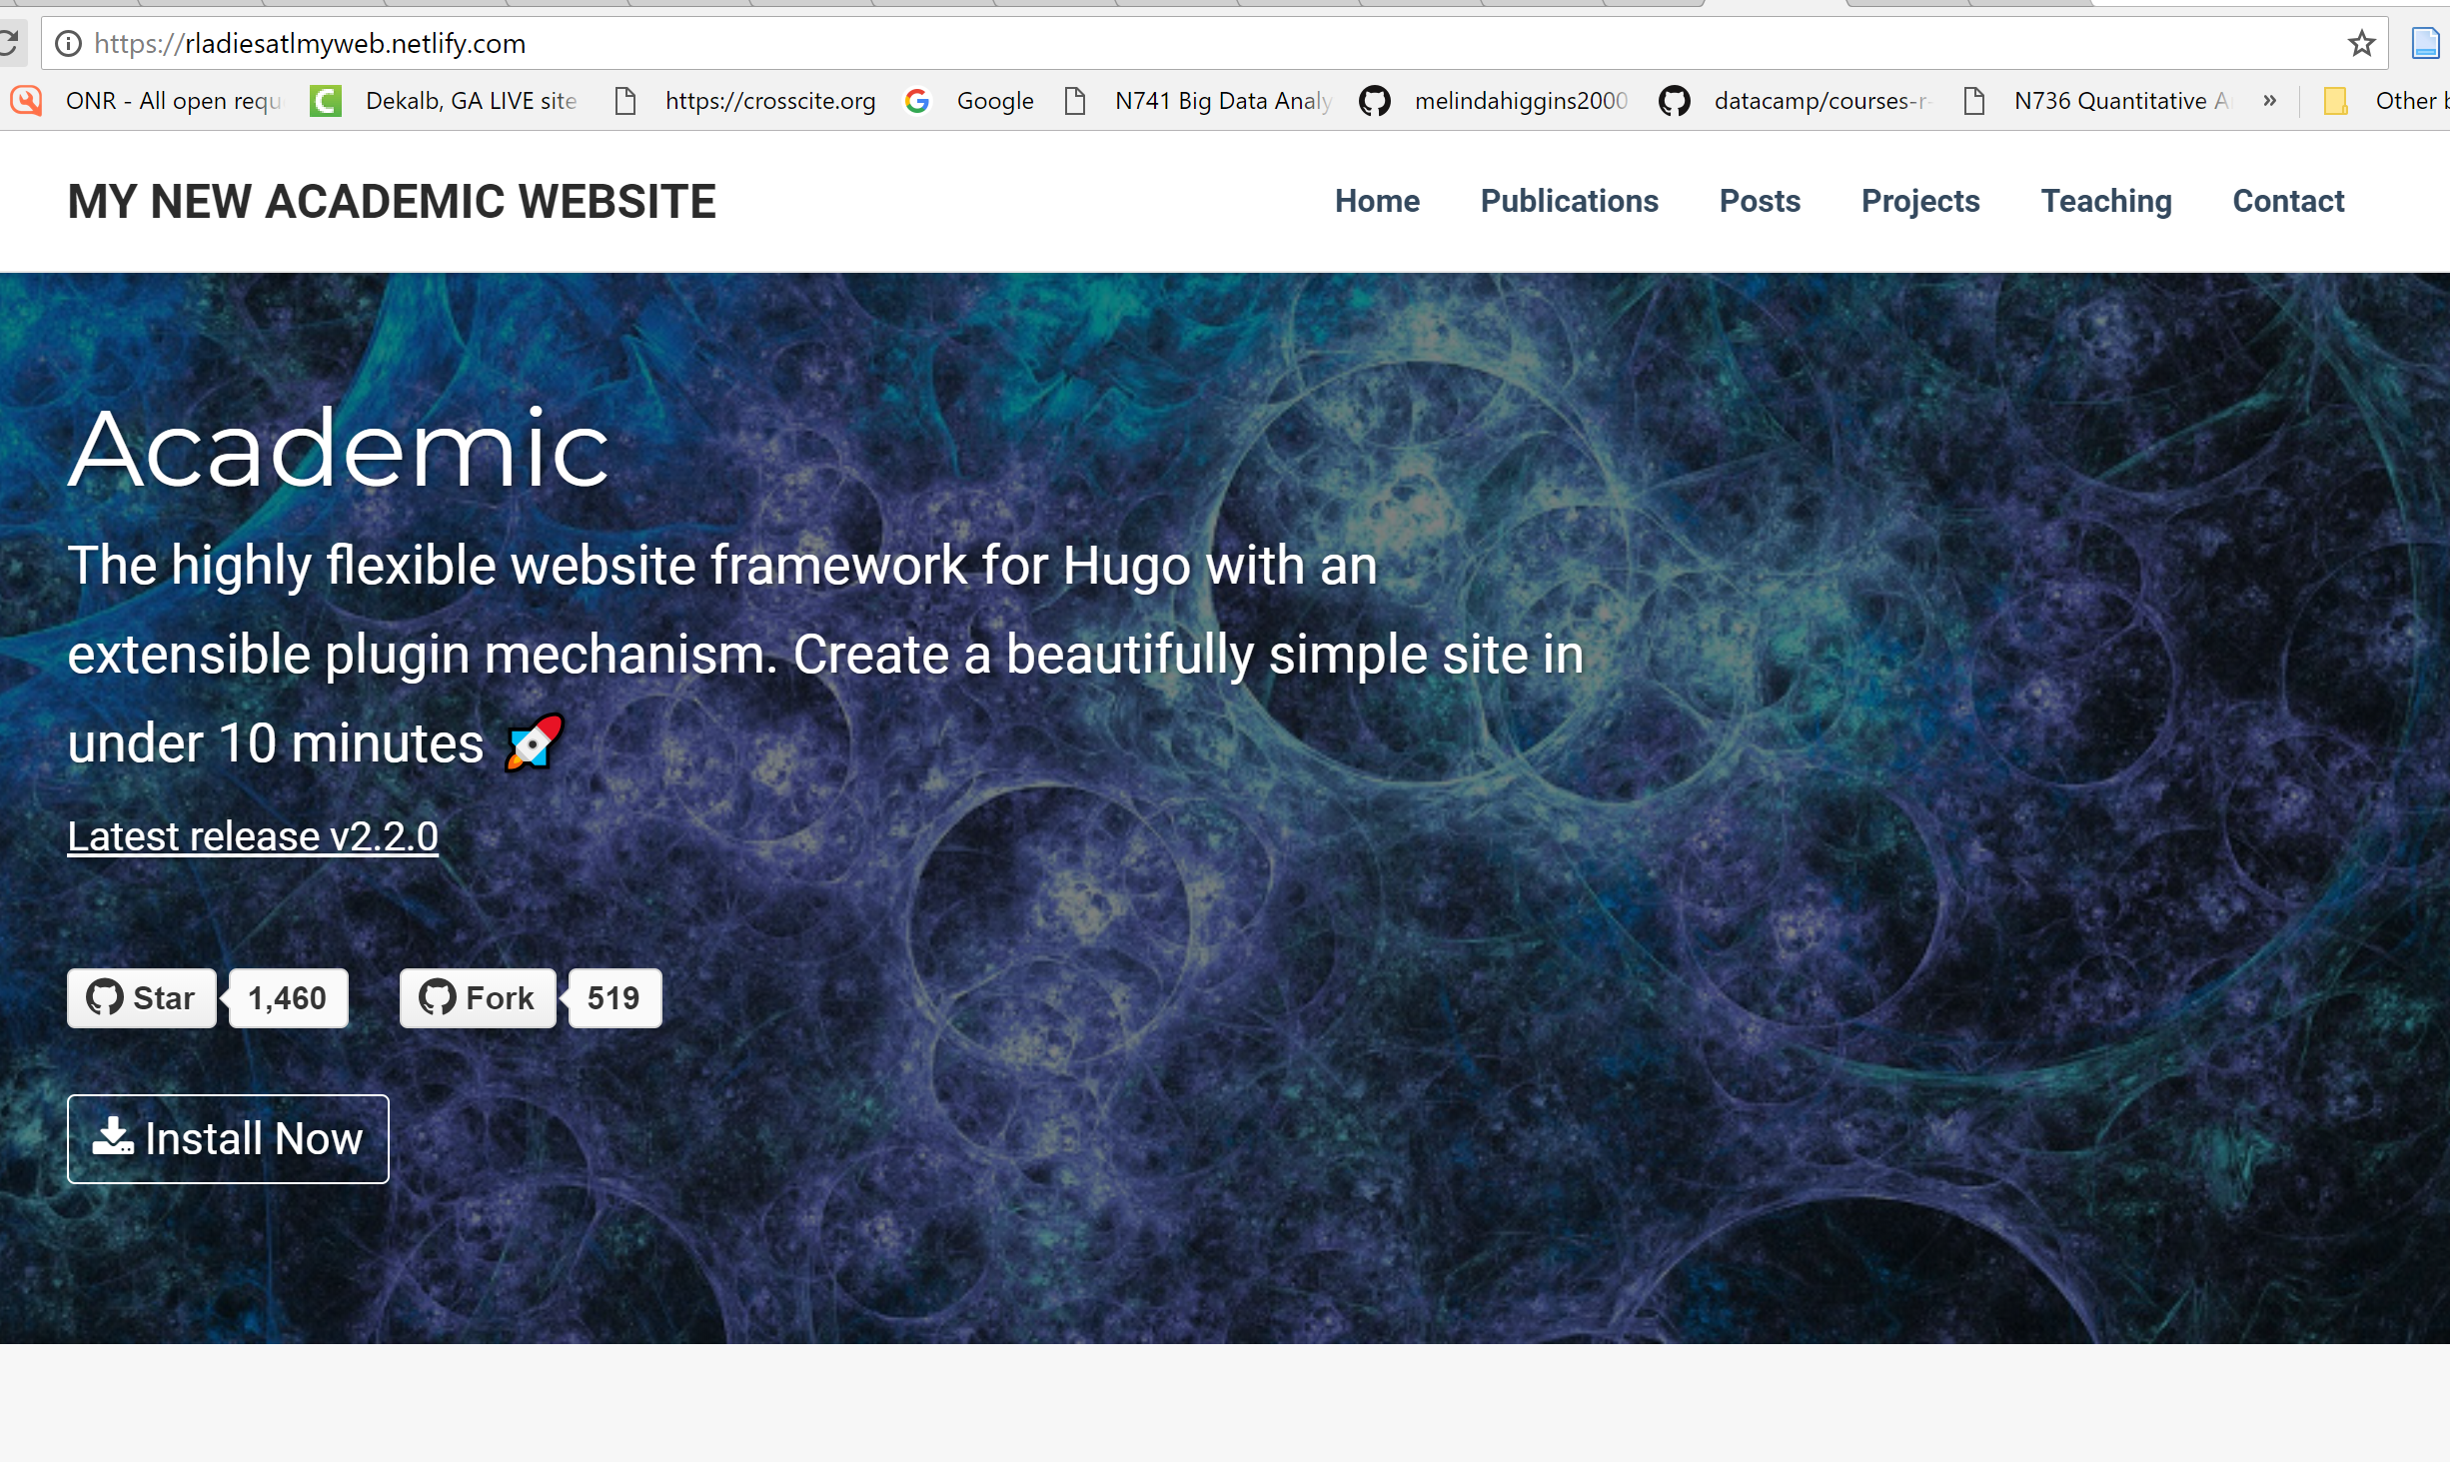
LookS right https://rladiesatlmyweb.netlify.com/

Slide 23
Edit config.toml
Local drive – create docs/ directory
publishDir = "docs"
baseurl = "https://melindahiggins2000.github.io/blogdownAcademic/"

Slide 24
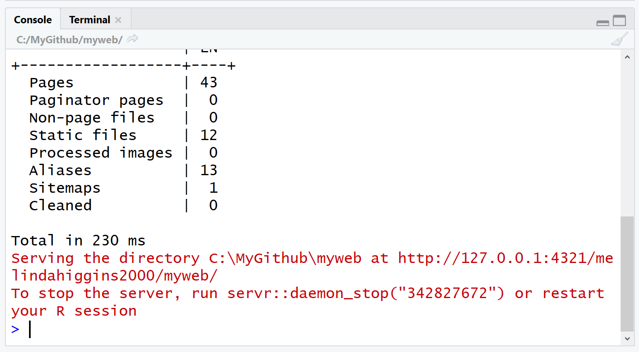
Serve site locally
View local browser
Files now in docs/
Resync with github
Git status
Git add .
Git commit –m “add files to docs”
Git push
Git status

Slide 25
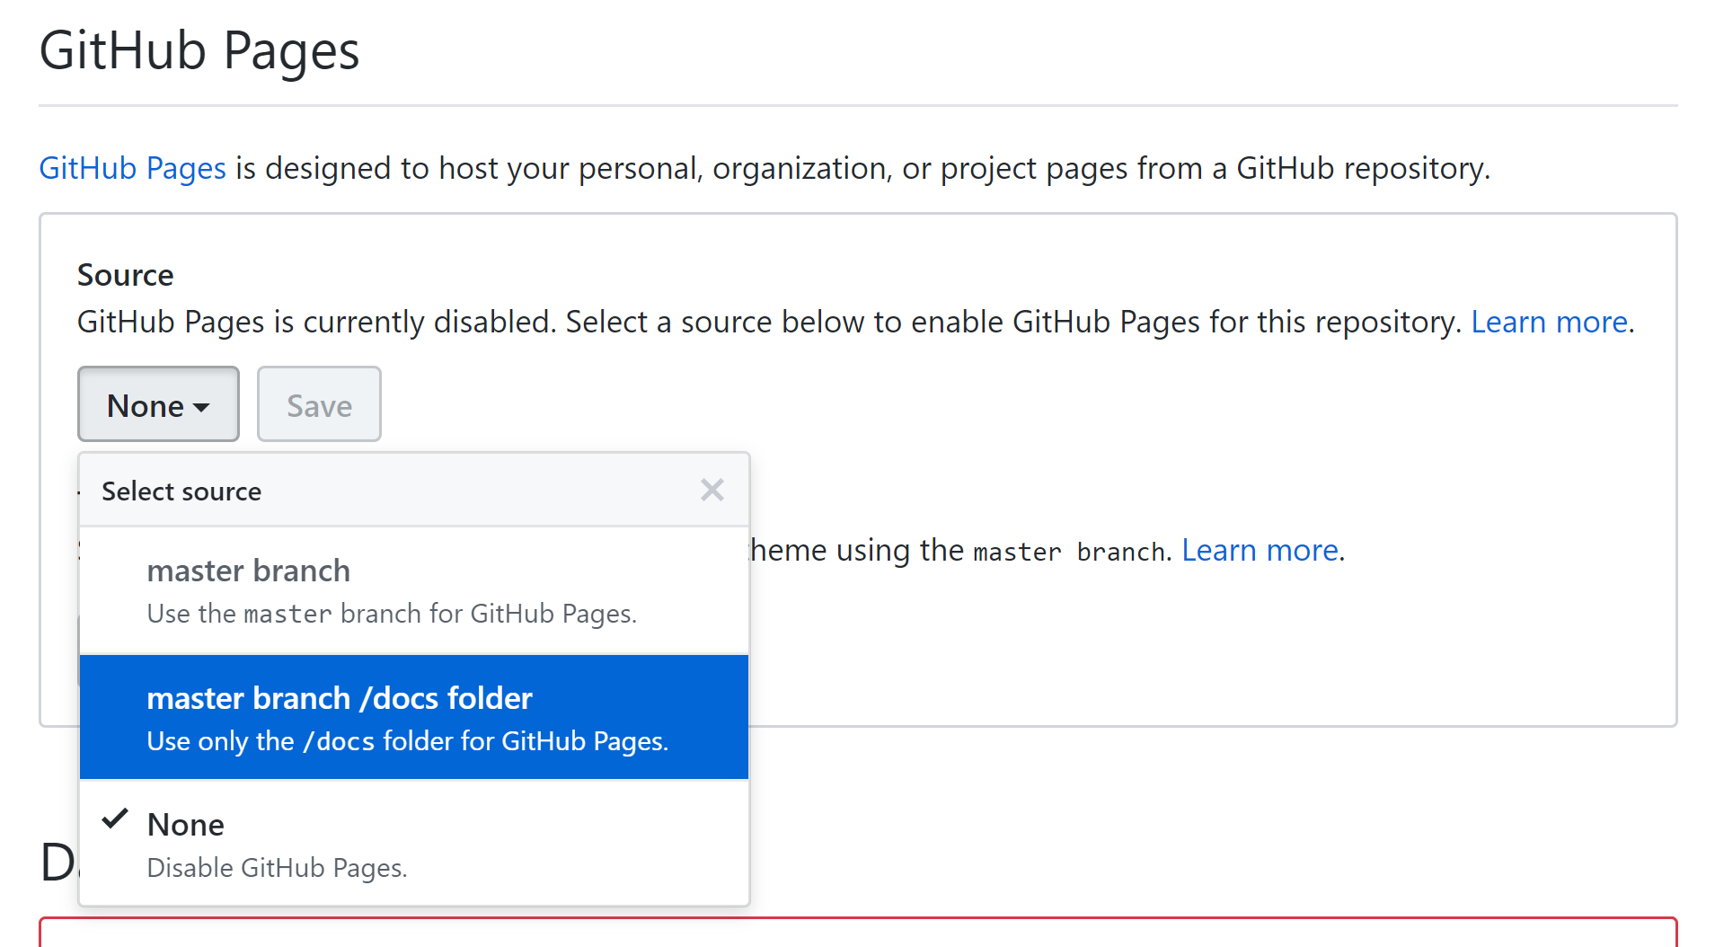
Setup github site
https://github.com/melindahiggins2000/myweb
Go to settings
Scroll down to github pages
Change none to docs
Click save
See url
May take a few minutes to showup
https://melindahiggins2000.github.io/myweb/ - but not as pretty as the local server

